Slide 1

Burmese Money Scam Detector
By
Nu Wai Thet(mmdt2024.001)
Myint Myat Aung Zaw(mmdt2024.044)
Kaung Myat Kyaw(mmdt2024.073)

Slide 2
Introduction
Background & Problem Statement
Digital fraud is rising in Myanmar due to political instability, economic hardship, and increased internet access.
Scammers use phishing, fake advertisements, gambling schemes, and financial fraud to target vulnerable individuals.
Burmese is a low-resource language, with limited NLP tools, posing difficulties for automated scam detection.
Lack of NLP-based scam detection models for Burmese

Slide 3
Introduction
Project Objectives
To raise awareness and prevent financial fraud in low-resource language settings
To develop a machine learning-based scam classification model for Burmese text.
To classify and detect Burmese money scam messages using NLP techniques.
To address data scarcity and linguistic challenges in scam detection.
To deploy a user-friendly tool to help the public identify potential scams.

Slide 4
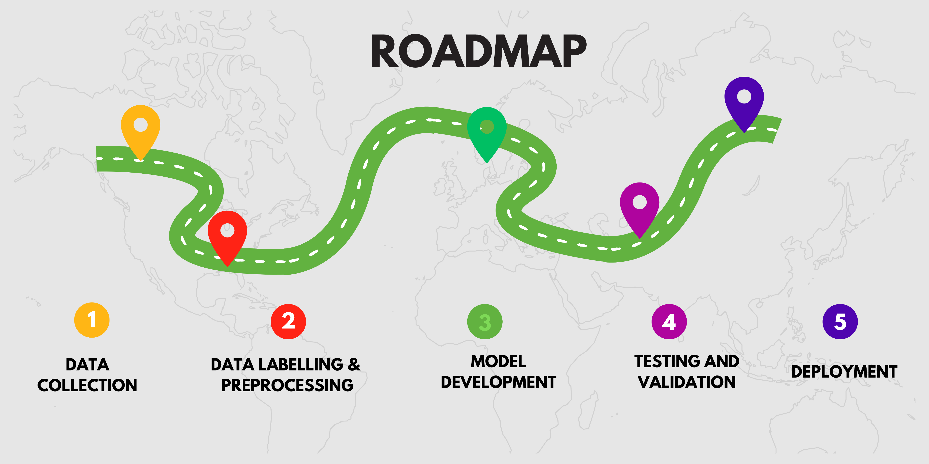

Slide 5
Data Collection
Data Sources
Data was collected from:
Public social media posts (Facebook, Telegram)
Victim-shared experiences
Common scam groups
Personal messages sent to mobile phones
Data Characteristics
Due to the scarcity of scam-related Burmese text data, we ensured:
Collection of legitimate advertisements from banks and official sources
Inclusion of diverse scam categories (e.g., gambling, investment fraud, fake job postings)
Generation of synthetic short sms scam messages to augment data

Slide 6
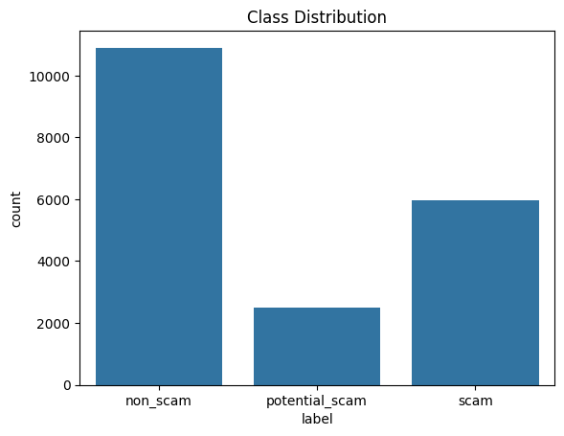
Data Collection
Dataset Composition
Total dataset size: 19,347 messages
Non-scam: 10,905
Potential scam: 2,481
Scam: 5,961

Slide 7
Data labelling
Manual labelling by Burmese native speakers
Three-Class Labelling:
Fraudulent (Red Flag): Confirmed scams
Non-Fraudulent (Green Flag): Legitimate business messages
Potential Scam (Yellow Flag): Suspicious but needs verification

Slide 8
Data Preprocessing
Standardization and Cleaning
Placeholder replacement (e.g., URLs, phone numbers, money amounts)
Emoji removal and counting
Stopword removal (English and Burmese)
Standalone number removal
Hashtag counting
Punctuation counting and removal
Text normalization (lowercasing, removing extra spaces)

Slide 9
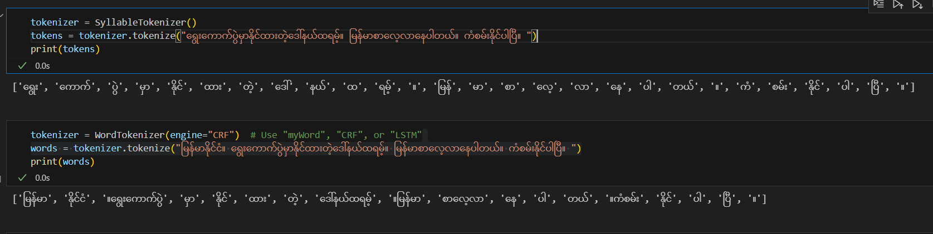
Data Preprocessing
Tokenization
Burmese and English text were tokenized separately using:
Custom myTokenize for Burmese (syllable and word tokenization)
nltk for English

Slide 10
Feature Extraction and Word Embedding
We experimented with the following feature extraction techniques:
TF-IDF (Term Frequency-Inverse Document Frequency)
Word2Vec - trained on current dataset
FastText -trained on current dataset

Slide 11
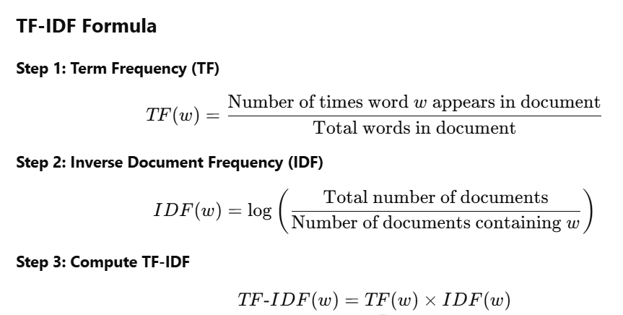
TF-IDF (Term Frequency-Inverse Document Frequency)
TF (Term Frequency): How often a word appears in a document.
IDF (Inverse Document Frequency): Rare words get higher scores, common words get lower scores.
TF-IDF: A higher value means the word is more relevant for classification.
Measures how important a word is in a document relative to the entire dataset.
Frequent words in one document but rare in others get higher scores.
Common words across multiple documents would have lower IDF

Slide 12
Word2Vec
Word2Vec is a neural network-based model that transforms words into continuous vector representations.
It captures semantic and syntactic relationships between words based on their context in a sentence.
Two architectures:
CBOW (Continuous Bag of Words): Predicts a word from surrounding context.
Skip-Gram: Predicts context words given a target word.
Efficient and scalable for large datasets.
https://arxiv.org/abs/1607.04606
How It Works?
Words with similar meanings have closer vectors in space.
Trained Word2Vec on our scam dataset to better capture fraud-related word relationships.
Example: "Scam" and "Fraud" will have similar vector representations.
Example (Simplified Vectors)
Word | Vector Representation
scam | [0.25, -0.10, 0.87]
fraud | [0.27, -0.12, 0.85]
policy | [-0.45, 0.22, -0.67]

Slide 13
FastText
What is FastText?
An extension of Word2Vec that captures subword information (word parts).
Handles misspellings and variations better than Word2Vec.
Especially useful for morphologically rich or low-resource languages.
https://arxiv.org/abs/1301.378
How It Works?
Breaks words into character n-grams (e.g., "scam" → "sc", "ca", "am").
Useful for detecting manipulated words (e.g., "scam" vs. "sc@m").
Word | Subword Chunks | Vector Representation
scam | [sc, ca, am] | [0.21, -0.09, 0.88]
sc@m | [sc, @m] | [0.22, -0.08, 0.86]
fraud | [fr, ra, au, ud] | [0.27, -0.12, 0.85]

Slide 14
Summary & Key Differences
Method | Representation Type | Learns from Context? | Handles Misspellings? | Captures Subwords? | Best For
TF-IDF | Word frequency-based | No | No | No | Simple keyword-based classification
Word2Vec | Full-word vectors | Yes | No | No | Understanding word relationships
FastText | Subword-based vectors | Yes | Yes | Yes | Handling typos & unseen words
Key Takeaways:
TF-IDF: Simple, effective for bag-of-words models but doesn’t capture meaning.
Word2Vec: Captures word relationships but struggles with misspellings.
FastText: Best for noisy text since it understands subwords and typos.

Slide 15
Model Selection
We trained and evaluated six classification models:
Logistic Regression
Decision Tree
Random Forest
XGBoost
SVM
Naive Bayes

Slide 16
Training Strategy for Scam Classification
Stratified K-Fold Cross-Validation
Maintains original class distribution in each fold
Best for handling imbalanced data
Ensures fair model evaluation
2. Train, Validation, and Test Split
Split dataset into Train (80%) and Test (20%)
Further split Train (80%) → Train Pool (80%) + Validation (20%)
3. Cross-Validation for Model Selection
Stratified K-Fold applied on Train Pool
Evaluate models using Accuracy, F1-Score, Precision, Recall, ROC-AUC, and Log Loss
Select the best model based on F1-Score (balance of Precision & Recall)
4. Hyperparameter Tuning
Tune the best model on the Validation Set
Goal: Optimize performance while avoiding data leakage
5. Final Training & Testing
Train the best model on the full Training Pool
Evaluate the final model on the Test Set (previously unseen data)
Get the final performance report

Slide 17
Results
Training Performance (F1-Score)
Model | Tfidf(syllable tokenization) | Tfidf(word tokenization) | word2vec | Fasttext
Logistic regression | 0.8673 | 0.8765 | 0.8586 | 0.8388
Decision Tree | 0.8211 | 0.8232 | 0.7882 | 0.771
Random Forest | 0.877 | 0.8775 | 0.8518 | 0.8389
XGBoost | 0.8831 | 0.8902 | - | -
SVM | 0.8878 | 0.893 | 0.8738 | 0.8644
Naive Bayes | 0.8476 | 0.8594 | - | -
Testing Performance on Best Model(F1-Score)
Feature Extraction | Best model | F1-Score | Precision | Recall | ROC-AUC
Tfidf(syllable tokenization) | SVM | 0.8852 | 0.8932 | 0.8814 | 0.9673
Tfidf (word tokenization) | SVM | 0.8935 | 0.9019 | 0.8897 | 0.9713
word2Vec | SVM | 0.8812 | 0.8963 | 0.8742 | 0.9657
Fasttext | SVM | 0.8759 | 0.8906 | 0.869 | 0.9629

Slide 18
Final Evaluation on Test Set
Overall Performance Metrics:
Accuracy: 0.8897
F1-Score: 0.8935
Precision: 0.9019
Recall: 0.8897
ROC-AUC: 0.9713
Classification Report
Class | Precision | Recall | F1-Score
Potential Scam | 0.64 | 0.84 | 0.72
Non-Scam | 0.95 | 0.91 | 0.93
Scam | 0.93 | 0.87 | 0.9

Slide 19
Findings
TF-IDF with word tokenization performed the best
SVM consistently outperformed other models
Word2Vec and FastText were less effective, likely due to limited training data
Limitations
Scammers frequently change tactics, requiring regular data updates
Low-resource NLP challenges make feature extraction difficult
Limited labelled data, impacting generalization

Slide 20
Deployment
Using Streamlit, we developed a simple user interface where:
Users input a message
The message undergoes preprocessing and tokenization
The SVM model predicts the classification
The output includes:
Danger Level: 🟥 High Risk, 🟧 Potential Scam, 🟩 Safe
Prediction Confidence
Suggestion message for the user
Link : https://burmesemoneyscamdetector.streamlit.app/

Slide 21
Thank You

Slide 22
Future Improvements
Regular Dataset Updates: Continuously collect new scam data
Multilingual Transfer Learning: Use multilingual models to enhance Burmese text processing
Anomaly Detection Techniques: Identify new scam trends using anomaly detection
Ethical Considerations: Ensure privacy and compliance with data protection laws

Slide 23
TF-IDF (Term Frequency-Inverse Document Frequency)
TF-IDF Example
Two Sample Documents
Doc 1: "Scam alert! Win money now."
Doc 2: "Government announces new policy."
Word | TF (Doc 1) | TF (Doc 2) | IDF | TF-IDF (Doc 1) | TF-IDF (Doc 2)
scam | 0.2 | 0.0 | 0.30 | 0.06 | 0.00
money | 0.2 | 0.0 | 0.30 | 0.06 | 0.00
government | 0.0 | 0.2 | 0.30 | 0.00 | 0.06
policy | 0.0 | 0.2 | 0.30 | 0.00 | 0.06

